Slide 1
Website wireframe
Product Crafts

Slide 2
Product Crafts
A banner that refreshes content every 10 secs (the picture and text should be refreshed)
Picture
text
Welcome to a new world of Innovation
A Canvas with an animated display
Product Crafts is a new product design company. At Product Crafts, we craft and deliver new-to-the-world products that are ready for production, marketing and sales.

Slide 3
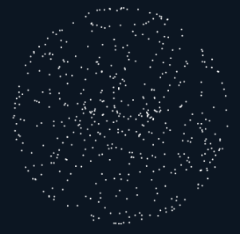
Product Crafts
Welcome to a new world of Innovation
Product Crafts is a new product design company. At Product Crafts, we craft and deliver new-to-the-world products that are ready for production, marketing and sales.

Slide 4

Product Crafts
Welcome to a new world of Innovation
Product Crafts is a new product design company. At Product Crafts, we craft and deliver new-to-the-world products that are ready for production, marketing and sales.
Pick up any product of your interest from our Design Gallery and kick start the production and sales process on Day 1
Invest in the world of Innovation and secure your business aspirations
Learn more →
Upcoming Products on The Design Gallery
Learn more →
Swaranjali
The Board
BOLT
BOLT
Crafters Cafe
C
C

Slide 5



Product Crafts
101010101010101010101010101010101010101010101010101010
101010101010101010101010101010101010101010101010101010
10101010101010101010 010101010101010101010101010
101010101010101010101 01010101010101010101010101010
1010101010101010101010 01010101010101010101010101010
1010101010101010101010 01010101010101010101010101010
1010101010101010101010 01010101010101010101010101010
101010101010101010101 1010101010101010101010101010
10101010101 101010101010101010
10101010101 0101010101010101010
10101010101 0101010101010101010
10101010101 0101010101010101010
: :: : ?
If Data is the New Oil, what is the New Data ?

Slide 6

Product Crafts
Who is John Galt ?

Slide 7

Product Crafts
What did DaVinci and Tesla discuss when they met ?

Slide 8

Product Crafts

Slide 10
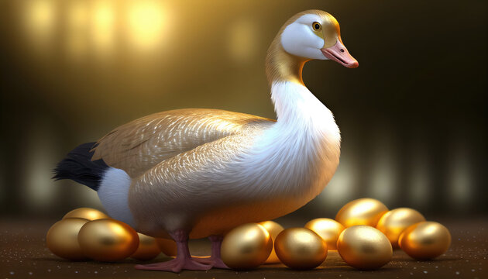
WHAT IS THE GOLDEN GOOSE OF PRODUCTS ?

Slide 11
WHAT IS THE GOLDEN GOOSE OF PRODUCTS ?

Slide 12

WHY IS GOLDEN RATIO SPECIAL?

Slide 13

WHAT DID DAVINCI AND TESLA DISCUSS?

Slide 14
WHAT DID DAVINCI AND TESLA DISCUSS?

Slide 15

IF DATA IS THE NEW OIL,
WHAT IS THE NEW DATA?

Slide 16


Slide 17
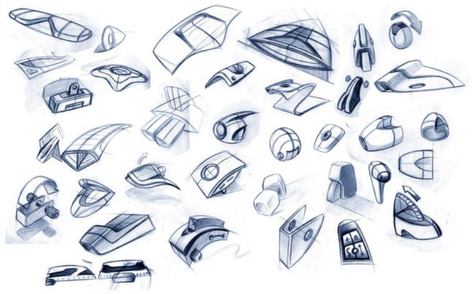

Slide 18


Slide 19

WHAT ARE DAVINCI AND TESLA DESIGNING?

Slide 21

WHAT IS THE GOLDEN EGG OF PRODUCTS ?

Slide 23

COMMING SOON

Slide 24
Product Crafts
Why is the Golden Ratio special ?

Slide 25
Product Crafts
Welcome to a new world of Innovation
Product Crafts is a new product design company. At Product Crafts, we craft and deliver new-to-the-world products that are ready for production, marketing and sales.
Pick up any product of your interest from our Design Gallery and kick start the production and sales process on Day 1
Learn more →
Partner with Product Crafts to bring your ideas to life
Learn more →
Invest in the world of Innovation and secure your business aspirations
Learn more →

Slide 26

Partnership with Product Crafts
Idea
Production
Design
Expertise Relocation
Marketing
Prototype
Sales
IP (Trade Secret / Patent)
Sale of Design & IP
Design Services
Documentation & Packaging
Product Crafts will own the design, development, prototyping, IP protection and deliverance of a ready-to-manufacture product that can be marketed and sold from day 1
Partner can start the production and sales post the sale of Design IP. Product Crafts will support with necessary kick start and post-production design services as required

Slide 27
Accelerate your Business Dominance with Product Crafts
Idea
Design Services
Design
Expertise Relocation
Production
Prototype
Marketing
Sale of Design & IP
IP (Trade Secret / Patent)
Sales
Product Crafts will deliver the design, development, prototyping, IP protection of ready-to-manufacture products that can be marketed and sold from day 1
Customer can start the production and sales post the sale of Design IP. Product Crafts will support with necessary kick start and post-production design services as required

Slide 28
Accelerate your Business Dominance with Product Crafts
Ideation & Design
Design Services
Prototype
Expertise Relocation
Production
IP (Trade Secret / Patent)
Marketing
Sale of Design & IP
Documentation & Packaging
Sales
Product Crafts will take ownership of the design, development, prototyping, & IP protection of ready-to-manufacture products that can be marketed and sold
Customer can start the production and sales post the sale of Design IP. Product Crafts will support with necessary kick start and post-production design services as required

Slide 29

Launch the product of your choice on Day 1
Design Services
Expertise Relocation
Production
Marketing
Sale of Design & IP
Sales
Browse our Gallery of Product Designs and select the product of your interest. We will transfer the full product design, IP and rights for you to launch the production and sales on day 1
You can start the production and sales post the sale of Design IP. Product Crafts will support with necessary kick start and post-production design services as required

Slide 30
Invest into Product IPs and Secure your Business Aspirations

Slide 31
Accelerate your Business Dominance with Product Crafts
Idea
Design Services
Design
Expertise Relocation
Production
Prototype
Marketing
IP (Trade Secret / Patent)
Sales
Sale of Design & IP
Documentation & Packaging
Product Crafts will take ownership of the design, development, prototyping, & IP protection for deliverance of ready-to-manufacture products that can be marketed and sold
Customer can start the production and sales post the sale of Design IP. Product Crafts will support with necessary kick start and post-production design services as required

Slide 32
Accelerate your Business Dominance with Product Crafts
Idea
Design Services
Design
Expertise Relocation
Production
Prototype
Marketing
Sale of Design & IP
IP (Trade Secret / Patent)
Sales
Product Crafts will deliver the design, development, prototyping, IP protection of ready-to-manufacture products that can be marketed and sold from day 1
Customer can start the production and sales post the sale of Design IP. Product Crafts will support with necessary kick start and post-production design services as required

Slide 33
The World of Product Crafts
Product Crafts is a network of polymathic individuals and organizations.

Slide 34
Partnership with Product Crafts
Idea
Design
Production
Prototype
Marketing
IP (Trade Secret / Patent)
Sales
Documentation & Training

Slide 36
Partnership with Product Crafts
Product Crafts networks with distinct polymathic and industries

Slide 37


